Slide 1
Electrical Circuits EEE 1131

Slide 2
Course Teacher
মোঃ সাফিউল ইসলাম
Assistant Professor, Dept. of EEE, KUET
Email: shafiul.islam41@gmail.com

Slide 3
Syllabus

Slide 4
Syllabus

Slide 5
Introduction
Topics:
Network terminology
Voltage
Current
Independent and Dependent sources

Slide 6
Cont.
Resistance
Basic laws
Ohm’s Law
KVL
KCL

Slide 7
Cont.
Simple resistive circuit
Series and parallel circuits
Voltage and current division
Wye-Delta transformation

Slide 8
Commonly used network terminology
Circuit
Branch
Node or Junction point
Loop
Mesh

Slide 9
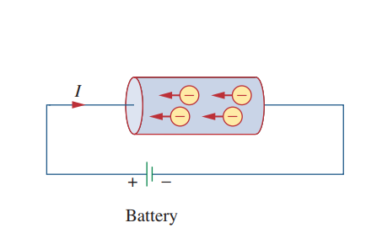
Circuit
A closed Conducting path through which a current flows or intended to flow.

Slide 10
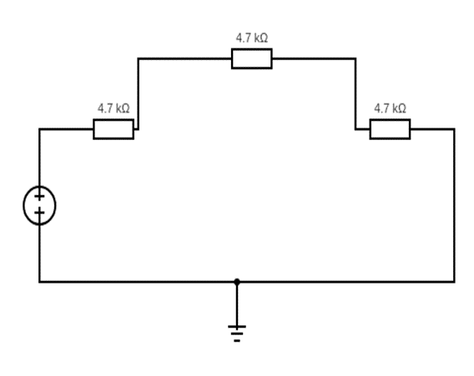
Branch
1
2
Any two terminal element in a electrical circuit or network is called a branch.
Ex. Resistor, inductor, capacitor, source, e.t.c.
How many branches are there in the circuit shown in left side?
1
2
1
2
1
2

Slide 11
Node or Junction
A node or junction is a point where at least two or more branches are connected together.
“KCL is applicable only at node or junction point”
How many node are there in the circuit?

Slide 12
Node or Junction
4 Nodes
2
3
1
4

Slide 13
Loop
A loop is a closed path formed by starting from a node and passing through a sets of node and returning back to the starting node without passing through any node more than once is called a loop.

Slide 14
Mesh
A Mesh is special type of loop that does not contains any other loop within it.
“KVL is applicable around any mesh or closed path”

Slide 15
Loop and Mesh
2
3
1
4

Slide 16
Voltage
Voltage (or potential difference) is the energy required to move a unit
charge through an element, measured in volts (V)

Slide 17
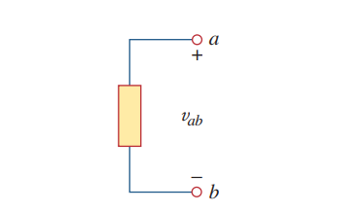
Voltage
The voltage between two points a and b in an electric circuit is the energy (or work) needed to move a unit charge from a to b; mathematically, $v_{ab}≜{dw}/{dq}$

Slide 18
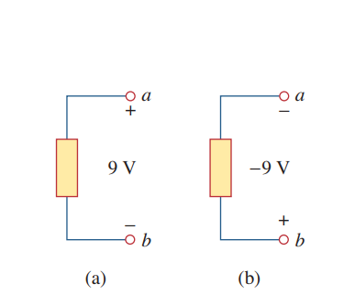
Voltage
Voltage at point a is +9V more than b
Or
voltage at point b is -9V more than a

Slide 19
Voltage
Potential rise from point b to a is +9V
And
Potential drop from point b to a is -9V

Slide 20
Voltage
Suppose you put a kick on a football
The football gets motion due to your kick
So kick is the cause and the motion of the football is effect kick---cause and
Motion of the football---effect
Similarly, Voltage is the cause and flow or displacement of charge (current) is effect

Slide 21
Current
Due to voltage or potential drop charge flow through the element.
And the rate of change of charge w.r.t time, t is called current.
Electric current is the time rate of change of charge, measured in
amperes (A). Mathematically,
$$i≜{dq}/{dt}$$

Slide 22
Classification Current
Two types
Direct Current (DC)
Alternating Current (AC)

Slide 23
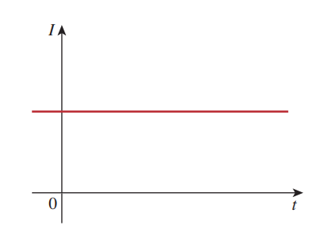
Direct Current
DC current is a current that remains constant with time.
By convention, the uppercase letters are used to represent DC quantities.

Slide 24
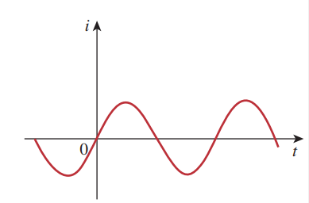
Alternating Current
An AC current is a current that varies sinusoidally with time.
By convention, the lowercase letters are used to represent AC quantities.

Slide 25
Direction of Current
We are defining the current as time rate of change of charge.
Conventionally,
Direction of current flow is taken opposite to the direction of flow of negative charge i.e., electron $e^{−}$flow direction
Direction of current flow

Slide 26
Cont.

Slide 27
Summary
Voltage is the energy or work needed to move a unit charge through an element.
Current is the time rate of change of charge due to the application of voltage.

Slide 28
Cont.
Voltage or potential difference or potential drop is always across the element or between two points.
But
Current is always through the element.

Slide 29
Voltage
Voltage is a point function. It is measured from a reference point. We measure voltage of any point w.r.t. a reference point called ground. The potential of ground is 0 V.

Slide 30
Single subscript notation
Potential of point a, w.r.t. ground or reference point is, V_{a0}
Potential of point b, w.r.t. ground or reference point is, V_{b0}
V_{a0} and V_{b0} are sometimes denoted as simply V_{a} or V_{b} instead of V_{a0} or V_{b0}
b
c
a
0
0 V

Slide 31
Single subscript notation
Voltage drop across resistor, R₁=V_{ab}
V_{ab}=V_{a0}-V_{b0}=V_{a}-V_{b}
V_{ab} is also called as voltage or potential difference between point a and b
b
c
a
R₂
R₁
R₃
0
0 V

Slide 32
Circuit Elements
Active elements
Passive elements
“An active element is capable of
generating energy while a passive element is not”

Slide 33
Circuit Elements
Active elements-Battery, Operational amplifier, Generator, Voltage source, current source
Passive elements-Resistors, inductors, capacitors

Slide 34
Active Elements
Two most common and important active elements are voltage source and current source
In a word “Source”
Two types
Independent sources
Dependent sources

Slide 35
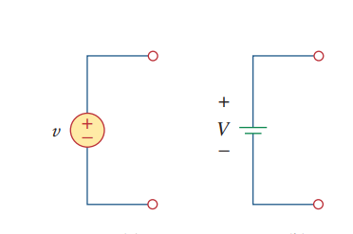
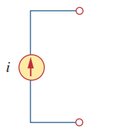
Independent Sources
An ideal independent source is an active element that provides a specified voltage or current that is completely independent of other circuit elements .
Independent Voltage source
Independent current source

Slide 36
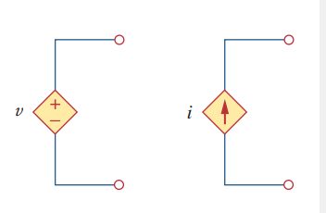
Dependent Sources
An ideal dependent (or controlled) source is an active element in which the source quantity is controlled by another voltage or current .
Dependent Voltage Source
Dependent Current Source

Slide 37
Dependent Sources
It may be either a voltage source or current source.
And it’s quantity can be controlled by either (another)voltage or current.
2 types or source and 2 type of controlling parameter, that’s why there are 4 possible dependent sources.

Slide 38
Dependent Sources
Voltage-controlled voltage source(VCVS)
Voltage-controlled current source (VCCS)
Current-controlled voltage source (CCVS)
Current-controlled current source (CCCS)

Slide 39
Dependent Sources

Slide 40
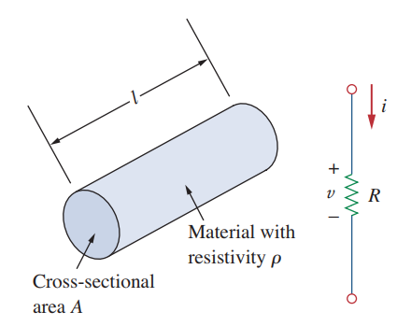
Resistance
The physical property, or ability
of a material to resist current, is
known as resistance and is
represented by the symbol R.
R=Resistance, ohm
A=Cross-sectional area in m²
$ρ$=resistivity in ohm-m

Slide 41
Basic Laws
Ohm’s Law
Kirchhoff’s Voltage Law (KVL)
Kirchhoff’s Current Law (KCL)

Slide 42
Ohm’s Law
Ohm’s law states that the current i flowing through the resistor is directly proportional to the voltage v across a resistor at a fixed temperature.
$$i∝V$$
$$i=GV$$
G-Conductance and opposite to resistance, R. $R=1/G$

Slide 43
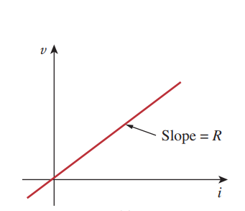
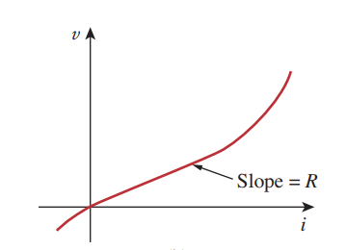
Ohm’s Law
$$i=V/R$$
$$V=iR$$
Linear Resistor
nonlinear Resistor
i
Slope=1/R
Slope=1/R
v
v
Graphical Representation of Ohms law

Slide 44
Two extreme possible value of R
Open Circuit (R tends to infinity)
Short Circuit (R tends to zero)

Slide 45
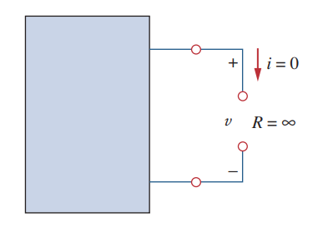
Open Circuit
An open circuit is a circuit element with resistance approaching infinity.

Slide 46
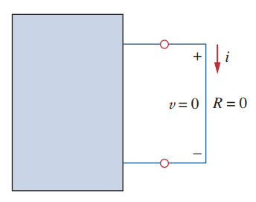
Short Circuit
A short circuit is a circuit element with resistance approaching zero.

Slide 47
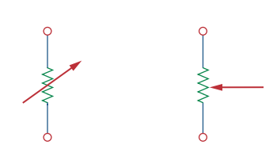
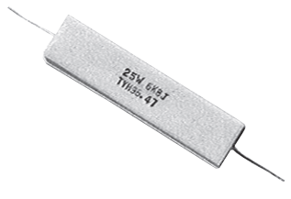
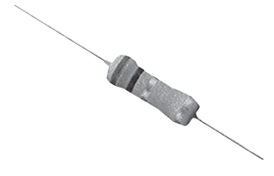
Classification of Resistors
Fixed Resistors
Variable Resistors
Variable Resistor
Wire wound type
Fixed
Carbon film type

Slide 48
Kirchhoff’s Voltage Law (KVL)
Kirchhoff’s voltage law (KVL) states that the algebraic sum of all voltages around a closed path (or loop) is zero Voltage rise + ve
Voltage drop- ve
$$\sum_{Closed path}{Voltages}=0$$

Slide 49
Kirchhoff’s Voltage Law (KVL)
$$\sum{Potential rises}−\sum{Potential drops}=0$$
$$\sum{Potential rises}=\sum{Potential drops}$$
“KVL is applicable only around a closed path or loop”

Slide 50
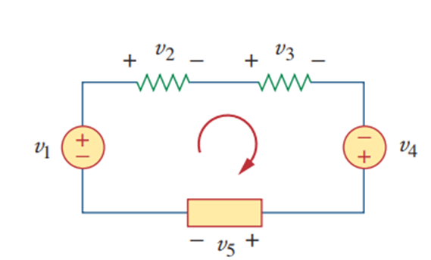
KVL
“Current entering point of an element is at higher potential than current leaving point of that element”

Slide 51
KVL
V₁+V₄=V₂+V₃+V₅
V₁-V₂-V₃+V₄-V₅=0
Sum of potential drops
Sum of potential rises
Algebraic sum of potentials
around a closed path

Slide 52
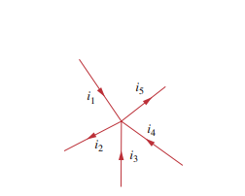
KCL
Algebraic sum of current entering and leaving at the same junction is equal to zero.
sum of Entering currents=sum of leaving currents
I₁+i₃+i₄=i₂+i₅
The sum of the currents entering a node is equal to the sum of the currents leaving the node

Slide 53
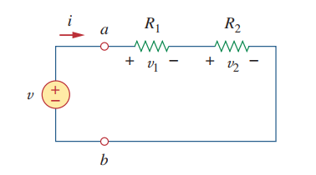
Series circuit and Voltage division
Let the current I
So V₁=i*R₁
V₂=i*R₂
Applying KVL,
V-V₁-V₂=0 or V=V₁+V₂ =i*(R₁+R₂)
i=V/(R₁+R₂)=V/R_{eq}
Therefore, R_{eq}=R₁+R₂
1
2
1
2
2
1

Slide 54
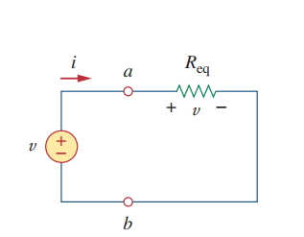
Series circuit and Voltage division
R_{eq}=R₁+R₂
two resistors can be replaced by an equivalent resistor, R_{eq}.

Slide 55
Series circuit and Voltage division
In a series circuit the current flows through each element is same.
But the supplied voltage is divided across the elements connected in series.
The total resistance is equal to sum of the individual resistances.
“The equivalent resistance of any number of resistors connected in series is the sum of the individual resistances.”

Slide 56
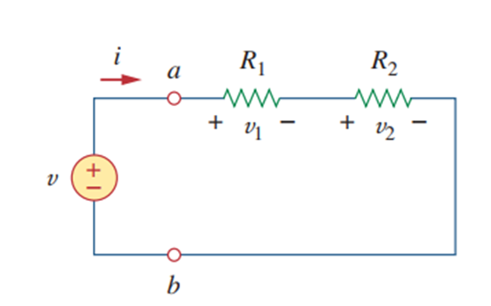
Series circuit and Voltage division
V₁=i*R₁ , V₂=i*R₂ and V=V₁+V₂
i=V/(R₁+R₂)
V₁={V/(R₁+R₂)}*R₁
V₂={V/(R₁+R₂)}*R₂
If R₁>R₂ then, V₁>V₂
If R₂>R₂ then, V₂>V₁
If R₁=R₂ then, V₁=V₂

Slide 57
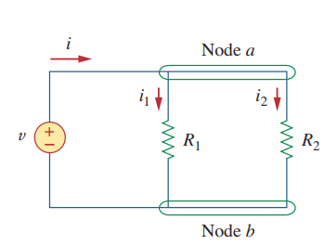
Parallel circuit and Current division
Voltage across each element in a parallel connection is same.
V=V₁=V₂
At node a applying
KCL, i=i₁+i₂
V/R_{eq}=V₁/R₁+V₂/R₂
1
1
1
2
2
2

Slide 58
Parallel circuit and Current division
V/R_{eq}=V₁/R₁+V₂/R₂
V/R_{eq}=V/R₁+V/R₂
1/R_{eq}=1/R₁+1/R₂
The equivalent resistance of two parallel resistors is equal to the reciprocal of the sum of the reciprocal of individual resistances.

Slide 59
Parallel circuit and Current division
In a parallel circuit the potential differences across each element is same.
But the total current is divided into individual currents of the elements at the node or junction.

Slide 60
Parallel circuit and Current division
R_{eq}=R₂=0 ohm
R_{eq}=R₁ ohm

